Slide 1
An Exposome data analysis pipeline in r
Project defense for master of science in software engineering
Jeff Sorbo
Advisor: dr. susan mengel, department of computer science
Committee member: dr. lisa gittner, department of political science
Texas Tech University

Slide 2
Project Summary
Exposome data
Ensemble data mining methods
Clustering
Decision trees
Association mining
R pipeline to automate analytic tasks

Slide 3
Presentation Overview
Data
Goals
Data loading and conversion
Attribute selection
Clustering
Decision trees
Association mining
Tools
Practices
Remaining work

Slide 4
Data
Exposome data for 3,125 county/parish units in US (Mario Pitalua)
Independent Variables – 60 variables including row IDs and county names
Dependent Variables – cardiovascular disease (CVD) rates in quintiles

Slide 5
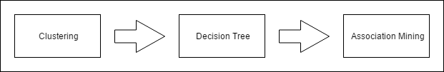
Analytic pipeline goal
Based on Datta, Soma: “A Multi-Stage Decision Algorithm for Rule Generation for Minority Class.” (August 2014)

Slide 6
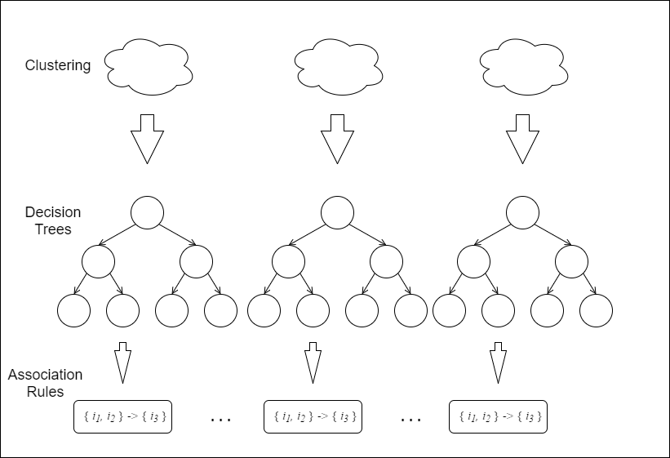
Analytic pipeline goal

Slide 7
Data loading and conversion
Data loaded from CSVs containing Independent, Dependent variables
All attributes given friendly names based on data dictionary
All attributes converted to numeric type, missing values removed
Independent merged with Dependent based on county names
All attributes converted to quintiles

Slide 8
Attribute selection
Paraclique attributes: ageadjustedpercent2004diabetes, ageadjustedpercentobesity2004, PH_SODA, … (10 attributes total)
“Statistical” attributes: educationHighSchoolOrAboveRate, perCapitaIncome, AvgDailyMaxAirTemperatureF, … (23 attributes total)

Slide 9
Clustering
K Means clustering algorithm run against paraclique data
3 clusters
Each data point labeled with cluster id {1|2|3}

Slide 10
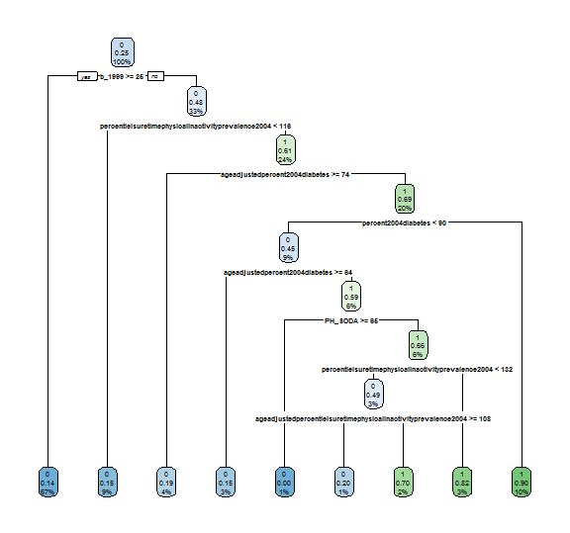
Decision tree: paraclique cluster 1
Accuracy 85%

Slide 11
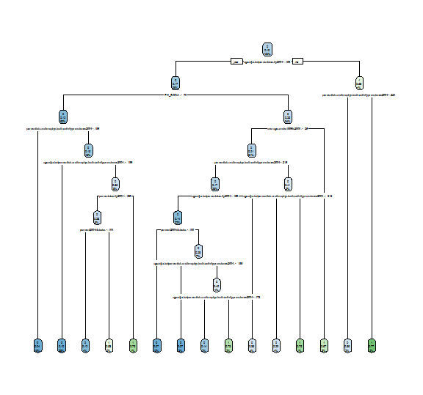
Decision tree: paraclique cluster 2
Accuracy 75%

Slide 12
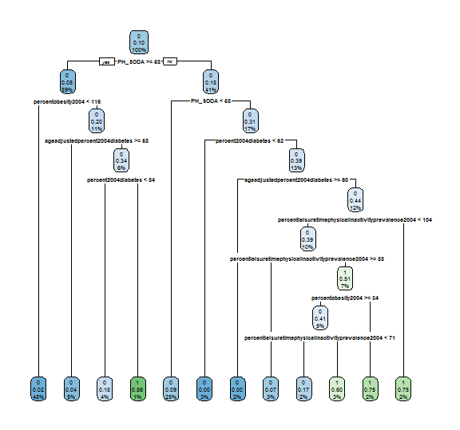
Decision tree: paraclique cluster 3
Accuracy 83.6%

Slide 13
Decision tree: non-paraclique cluster 1
Running rpart triggered an error
All data points in cluster 1 have CVD = 0

Slide 14
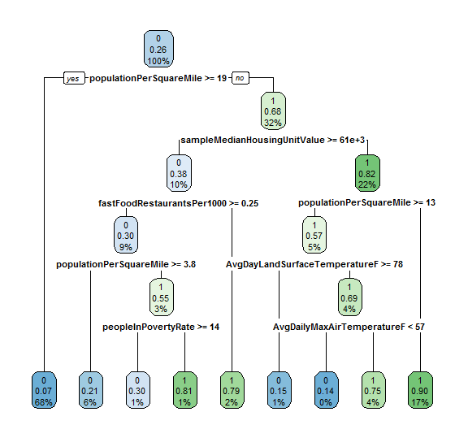
Decision tree: non-paraclique cluster 2
Accuracy 88.1%

Slide 15
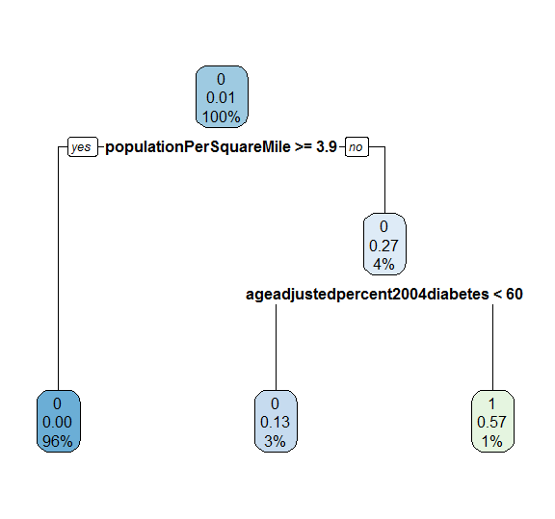
Decision tree: non-paraclique cluster 3
Accuracy 98.6%

Slide 16
Quintiles and Binary incidence matrices
Association rules mining requires data in a transaction format.
{ “trans_id” : 1, “items” : [ “milk”, “eggs”, “bread” ] }
{ “trans_id” : 2, “items” : [ “eggs”, “bread”, “bananas” ] }
The exposome attributes are real numeric types
{ “AvgDailyPrecipitationmm” : 2.87, “cvdQuintile” : 1 }
{ “AvgDailyPrecipitationmm” : 8.34, “cvdQuintile” : 2 }
How do we make our exposome data available for association mining?

Slide 17
Quintiles and Binary incidence matrices
We can group our real-valued attributes into quintiles and then convert them into a binary incidence matrix
[ { “id” : 1, “precip” : 2.87 }, { “id” : 2, “precip” : 8.34 } ]
[ { “id” : 1, “5tile.precip” : 1 }, { “id” : 2, “5tile.precip” : 3 } ]
id | 5tile.precip.1 | 5tile.precip.2 | 5tile.precip.3 | 5tile.precip.4 | 5tile.precip.5
1 | 1 | 0 | 0 | 0 | 0
2 | 0 | 0 | 1 | 0 | 0

Slide 18
Tools used
MongoDB
R 3.3.3
R Studio
GitHub - https://github.com/jsorbo/r-exposome

Slide 19
Mongodb
Loaded data into MongoDB
Retrieved data from MongoDB using R library

Slide 20
Best practices
Google style guide
Do not save workspace – rerun scripts
Workflow of file names
Version control

Slide 21
Remaining work
Attempt to reduce attribute repetition in decision tree paths
Stop recursing after a few levels
Apply association mining to leaf nodes
Combine association rules with decision tree rules
Attempt to automate this work
Evaluate ensemble model
Explore additional attributes

Slide 22
Questions?

